Slide 1



Chowgacha - Jhenaidah Model
Dr. Md.Emdadul Haque
Senior National Consultant C -J model replication committee

Slide 2
Background History of C-J Model
The program starts in Chowgacha UHC in 1985.
Social mobilization program starts in Lohagara UHC , Narail from 1989 - 1995
In 1995 model activities started effectively.
In June 2008 ,MOH&FW declared the Chowgacha UHC as Model UHC .
In 2010 D G of WHO recommended to replicate it.
Jhenaidah Sadar Hospital Model starts in 2012
C-J Model replicate in 2015 by MOHFW in 11 district hospital & 5 Upazilla UHC.
Replicating by the order of PM office, ADG(Admin) is the Chairperson for replication.

Slide 3



CHOWGACHA UPAZILA HEALTH COMPLEX
Chowgacha, Jessore.
Previous UHC
Present UHC

Slide 4
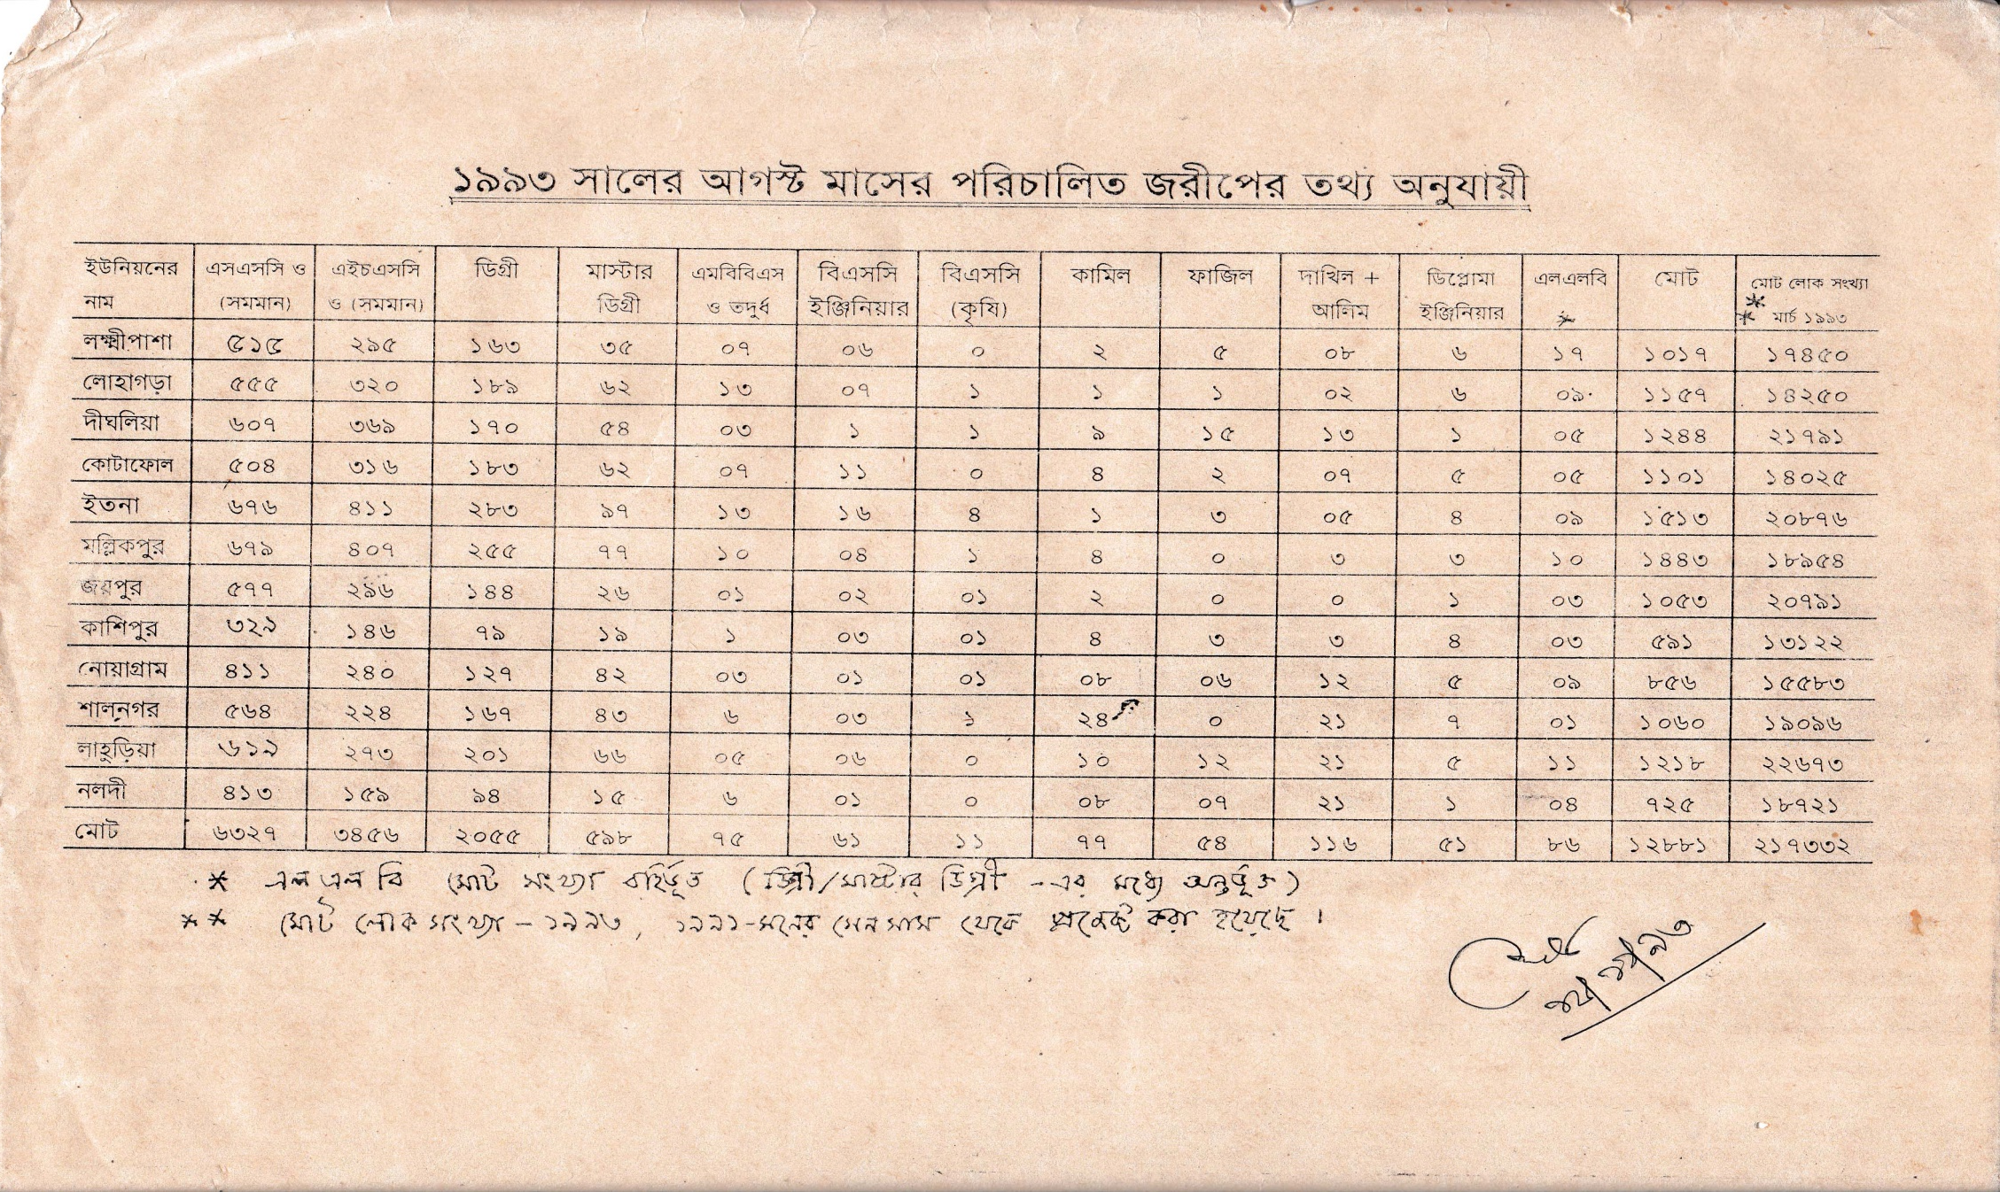
নড়াইলের লোহাগড়া উপজেলায় ইউনিয়নওয়ারী জরীপে জনসম্পদের তথ্য

Slide 5




Community Mobilization Meeting at Lohagara in 1995

Slide 6
A Hospital with a Vision …
Maximum utilization of Govt.
resources with
honesty and sincerity.
Integrated approach of
Administration,& Community
Leaders .
Providing Effective services
through improved
management system.

Slide 7
Characteristics of C-J Health Management Model
Leadership (group / single) in health management.
Goal oriented activities & community engagement.
Optimum use of government resources.
Implement all the component of primary health care .
5. Ensuring corner-based health care.
6 Improve maternal & child health.

Slide 8
Characteristics of C-J Health Management Model
7.Cleanliness and beautification of the facility .
8. Birth and death recording for progress assessment
9.Provision of safe blood transfusion.
10.Implementation of the 5S KAIZEN-TQM
11. Improved financial management .
12.Both the institutions awarded many times

Slide 9


Blood donation program stared in 16 December, 1996 in Chowgacha UHC
A seminar held on basic information system at Chowgacha Degree College in June, 1997. DC Jessore was the chief guest .

Slide 10


Health Education Session

Slide 11


Community supported volunteer working in ANC corner
Community Supported Volunteer Working as receptionist.

Slide 12

Upazila Health Complex
CHOWGACHA , JESSORE.
EOC Activities : 1997- 2011 (Hospital Delivery )

Slide 13

Upazila Health Complex
CHOWGACHA , JESSORE.
EOC Activities : 2000 - 2011 (Caesarian Section)

Slide 14
Upazilla Health Complex
CHOWGACHA , JESSORE.
COMMUNITY SUPPORTED MANPOWER
TOTAL :46
  Volunteers :26
  Cleaners & guards :16
  Others :04
  The remunerations come from
  Outsourcing :25
  Service provider :21
  The amount of remuneration ranging from 200/= To 8000/=tk. Per month depending upon the style of work, which costs a total of nearly 90,ooo/=Tk per month.

Slide 15
Chowgacha Health Complex – improvement evaluation (1995-2017)
Subject | 1995 | 1996 | 2000 | 2007 | 2011 | 2017
Bed Occupancy Rate % | - | - | 93.5 | 201 | 208 | 171
ANC (First Visit)% | - | 16.3 (817) | 59 (2861) | 132 (7292) | 170 (8935) | 130 (6632)
Hospital Delivery Rate % | - | 2.1 (99) | 6.4 (422) | 38.1 (1899) | 98.4 (4413) | 66 (2932)
C-Section rate % | - | .02 (1) | 0.07 (3) | 9.6 (473) | 22.5 (1107) | 17
MMR/100,000 live births | 599 | 300 | 168 | 160 | 68 | 91
NMR/ 1000 live births | 42 | 47 | 23 | 21.5 | 18.2 | 16.6
IMR/ 1000 live births | 65 | 58 | 36 | 29.2 | 23.6 | 18.6
U5MR/ 1000 live births | 78 | 67 | 44 | 33.3 | 25.7 | 21.1

Slide 16
Achievement of Chowgacha Health Complex
    Chowgacha UHC declared as the model upazilla health complex in 2008.
  Chowgacha UHC achieved MDG target in 2009.
  Awarded for best performance in EOC form 2005 to 2014 and 2017,2018.
  Achieve Health ministers Award for its best performances in 2016 to 2018.
  The govt. taken the initiative to upgrade to 100 bedded in 2018.

Slide 17



দৈনিক প্রথম-আলোর প্রতিবেদন
১৪ অক্টোবর, ২০০৫
চৌগাছা পরিদর্শন, ১০ মার্চ, ২০১০

Slide 18

100 kh¨v wewkó m`i nvmcvZvj, wSbvB`n

Slide 19
Challenges of the hospital in 2012
Insecured hospital environment
Performance of all activities was very low
Very limited support staff
Receiving money from the patients by non-govt. staff
Waste management system was poor
Monitoring meeting was not performed regularly

Slide 20
Comparative data of health facilities of different country of the world
SL NO | Country | Per capita health Expenditure per year by Govt. ($) | Doctors per 10000 Population | Nurse per 10000 Population | Beds per 10000 population | Out of pocket expenditure %
01 | USA | 9536 | 25.5 | 99 | 37 | 11.08
02 | UK | 4356 | 28.0 | 84 | 30 | 14.79
03 | Malaysia | 386 | 12.8 | 34 | 18 | 36.67
04 | Sri Lanka | 118 | 7.3 | 17.5 | 31 | 38.43
05 | India | 63 | 7.3 | 20.4 | 09 | 65.06
06 | Nepal | 44 | 08 | 4.7 | - | 60.41
07 | Pakistan | 38 | 08 | 06 | 06 | 66.40
08 | Bangladesh | 37 | *05 | *03 | *05 | 67.00
From internet 2017

Slide 21
Community Support in Jhenaidah Sadar Hospital
Human resource 56
  Cleaner 21
  Ayah & ward boy 22
  Guard 7
  Volunteer 3
  Trolley man 3
Paurasava supports
  Cleanliness
  Renovation of pediatric word
  A biochemistry analyzer.
Others
  A generator
  An inter-com

Slide 22


Deputy Commissioner (DC), Jhenaidah visited the Sadar Hospital to observe the Hospital activities.
Superintendent of Police (SP), Jhenaidah visited the Sadar Hospital to observe the Hospital activities and to ensure security of the hospital.

Slide 23


Innovative activities of Jhenaidah Sadar Hospital Page: 1
Community engagement
Big Cleaning Day

Slide 24


Internal Monitoring System
Meting of community support group committee
Monthly meeting schedule

Slide 25


Use of color code in official file arrangement

Slide 26




Changes in EOC Ward
Before
After
Before
After

Slide 27







Changes in pediatric ward and waste management
Before
After

Slide 28
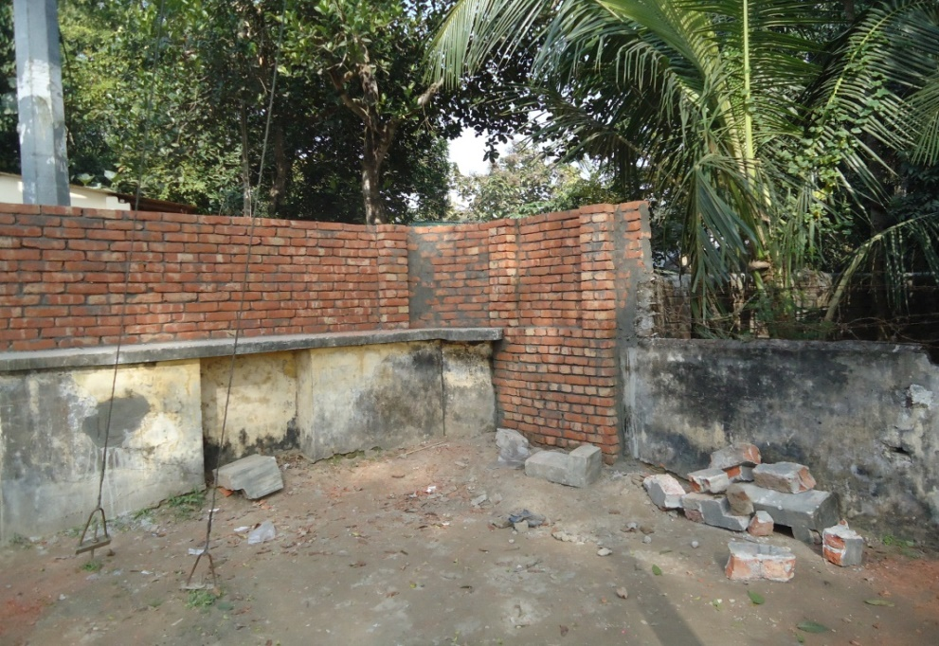

Improved security and recovery of valuable land
Campus protection
Recovered Valuable land after 50 years

Slide 29

Sadar Hospital, Jhenaidah
Bed Occupancy Rate from 1998 to 2018

Slide 30
Emergency & Out Door, Indoor Service 1998 to 2018
Sadar Hospital, Jhenaidah

Slide 31
3 best performing EmOC Hospital in Khulna division - 2018
Sadar Hospital, Jhenaidah

Slide 32
Comparative data of revenue income (in Taka) from 2015 to 2018
Sadar Hospital, Jhenaidah

Slide 33
Achievements of Jhenaidah Sadar
Hospital
1. Active Community Participation is an example in Bangladesh.
2. Improved performance of all services.
3. Improved Cleanliness and Beautification of Campus.
4. Functioning of X-Ray service and Biochemistry investigation
5. Improved Security
6. Improved Financial Management
7. “Model ” is replicating in 20 district hospital & 40 Upazilla hospital
8. The hospital is awarded 7 times from 2013 to 2018.

Slide 34




Improved pediatric word by local initiative

Slide 35




Hospital Environment

Slide 36
Lessons learned
Public health and hospital services and resources are inadequate vis-à-vis the need specially for the poor
This gap can be minimized through local participation.
Effective health service and hospital management require local support and participation.
Health personnel, specially the local health manager should take the role of catalyst
Local support can be attracted through improved services, and visible efforts and morality of the health managers
MOHFW can take initiative to roll out the model and the message
Jhenaidah-Chowgacha team will happy to volunteer

Slide 37

Thank You
Notes:
37

Slide 38
Community support in Chowgacha UHC
  Human resource 46
    Volunteer 26
    Cleaner&guard16
    Others 4
  A mobile phone
  Dustbins
  A reception center
  Tiles around the pillars of outdoor
  Beautification of road
  Others
    ANC, PNC, Growth Monitoring card
    Drugs for Arsenicosis
    Tyars of Ambulance
    Protocol board

